Slide 1

EDA on Work-life balance
DSC680 Course Project: Milestone 3 - Project Proposal Vasanthakumar Kalaikkovan

Slide 2
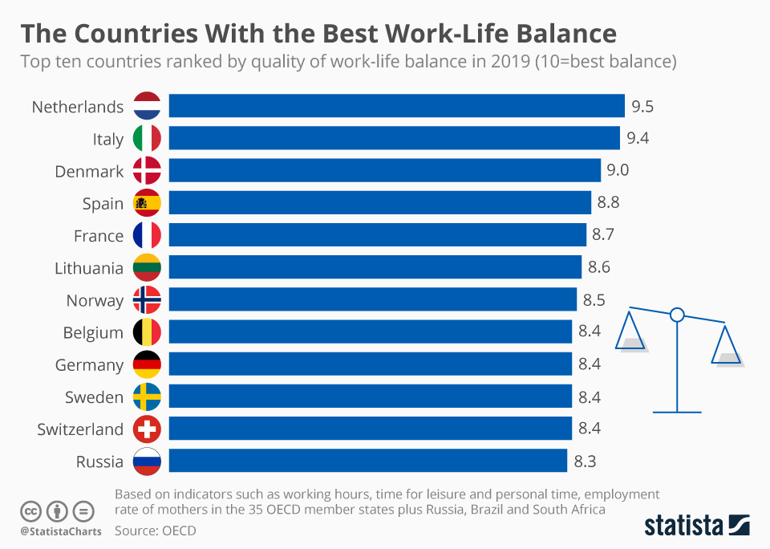
Background of the problem
Here are some key findings, Workers average just 2 hours and 48 minutes of productive device time a day.
21% of working hours are spent on entertainment, news, and social media. 28% of workers start their day before 8:30 a.m.
26% of work is done outside of regular working hours. We check email and instant messaging, on average, every 6 minutes.
40.1% of our day is spent multitasking with communication tools.

Slide 3
Process Overview
Preliminary analysis on data
Data preparation and cleaning
Exploratory Data Analysis
Observations

Slide 4
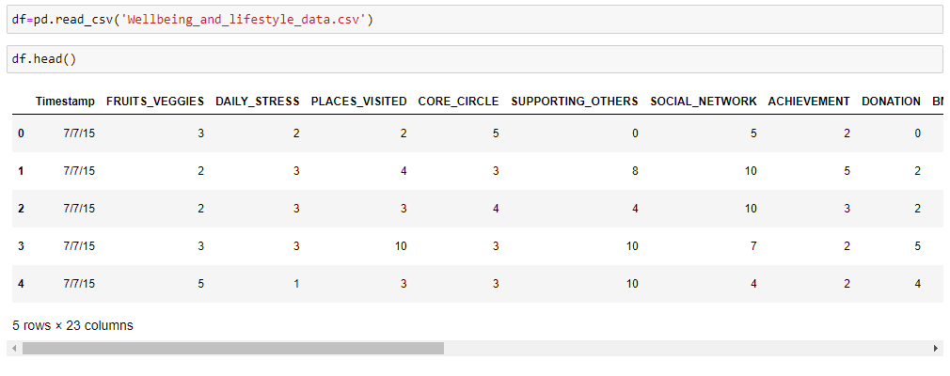
Data Preparation

Slide 5
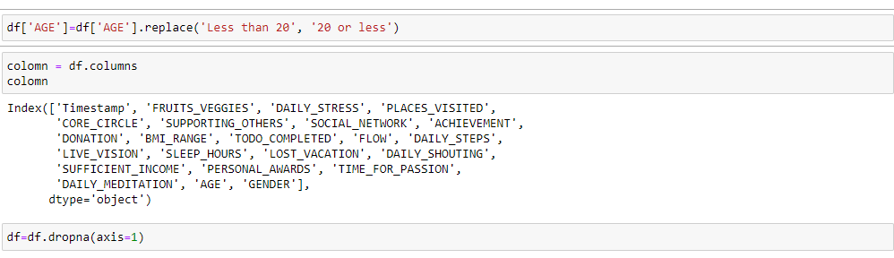
Data Cleaning

Slide 6
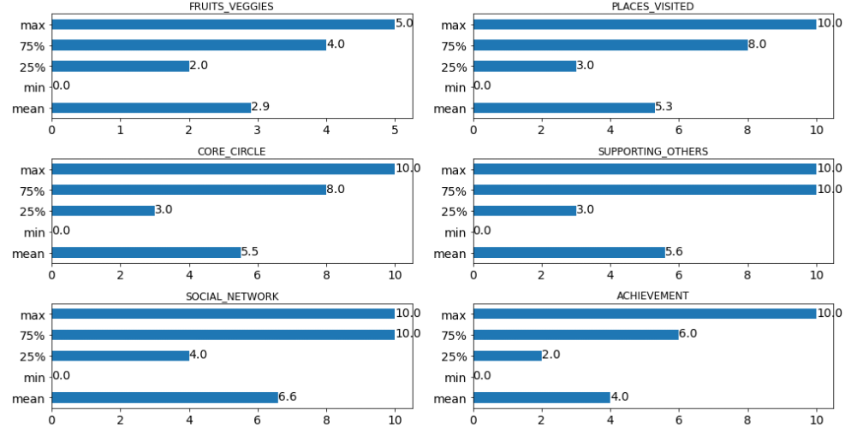
Exploratory Data Analysis (Description)

Slide 7
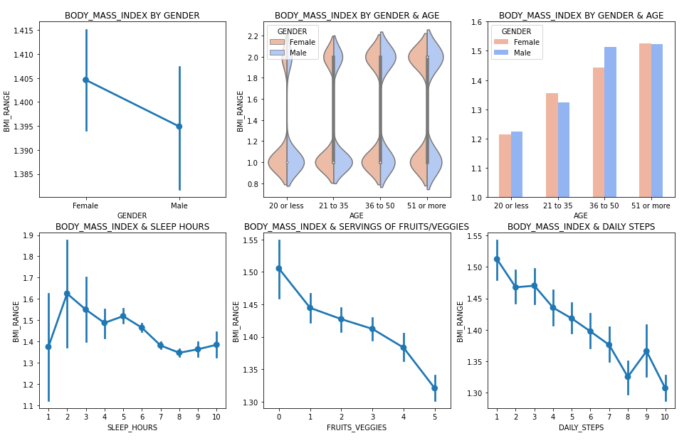
Exploratory Data Analysis (Healthy body)

Slide 8
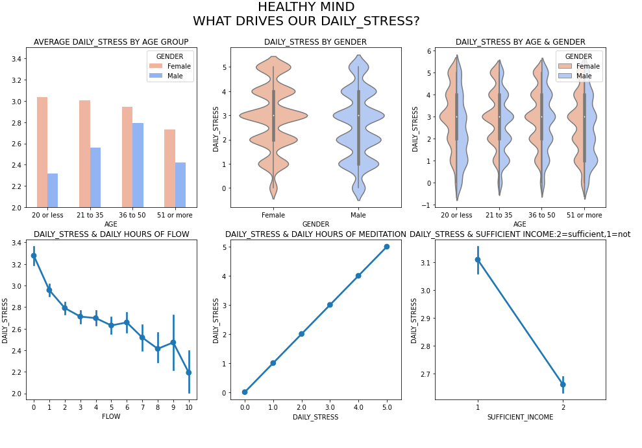
Exploratory Data Analysis (Healthy mind)

Slide 9
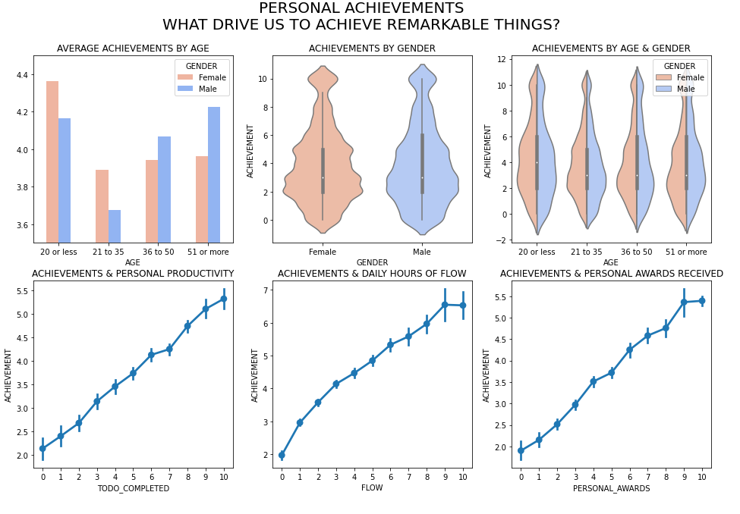
Exploratory Data Analysis (Expertise)

Slide 10
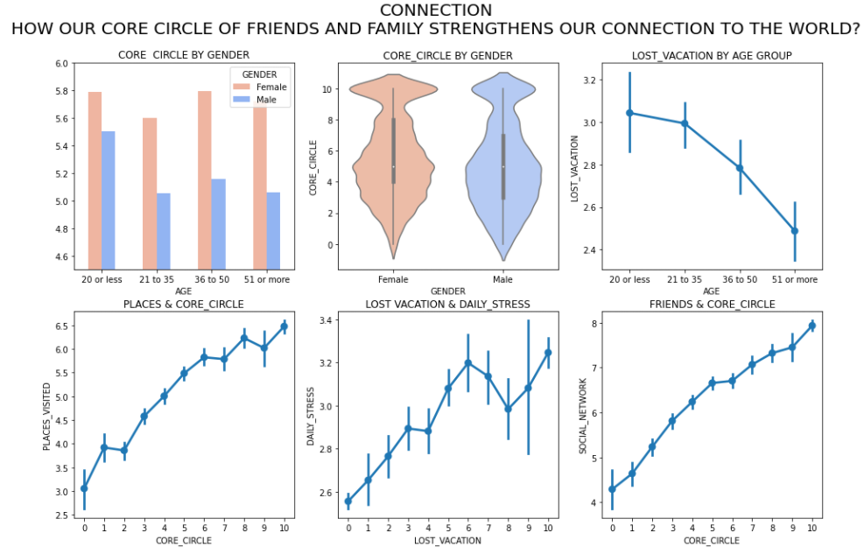
Exploratory Data Analysis (Connection)

Slide 11
Conclusion
Our BMI is most influenced by a quality nutrition (fruits/Vegetables) and physical activity (daily steps)
Key influencers of our stress level are our ability to concentrate on our work during flow sessions, daily meditation and the sufficiency of our income.
Those of us who achieve the most remarkable things, have also maximized our productivity (completing our daily to-do list), focus on our activities (flow sessions) and have earnt multiple personal awards and recognition.

Slide 12
Reference
Work-Life Balance Survey EDA | Kaggle
The problem with work-life balance: it's actually a rollercoaster - Ness Labs
The art of living a good life. Check your Happiness Score. Access free content. (authentic-happiness.com)

Slide 13
Thankyou

